Slide 1


Highlights from the Evaluation of the Robert Noyce Teacher Scholarship Program
Frances Lawrenz
and
The Noyce evaluation team
University of Minnesota
Acknowledgement:
This project was funded by National Science Foundation (Grant#REC0514884)

Slide 2
U of MN Noyce Evaluation
The Noyce Program Evaluation seeks to partner with projects to create an evaluation that will supplement current evaluations and provide relevant and timely results on the impact of the Noyce Program.
http://cehd.umn.edu/EdPsych/NOYCE/
  The Web site includes:
  searchable literature database
  project evaluation database and instruments used in Noyce Projects
  theoretical framework
  policy briefs and evaluation reports about STEM recruitment and retention
  reports, conferences, and presentations

Slide 3
Data Collection Methods
Surveys
  PI online survey (N=66)
  Scholar online survey (N=555)
  Disciplinary faculty online survey (N=80)
Interviews
  Scholars (N=39)
  Districts (N= 17)
  STEM faculty (N=13)
ORC monitoring data collected for NSF

Slide 4
Scholar Demographics
Average GPAs was 3.5 when received funding
48% career changers
Majoring in a range of STEM areas:
  39% mathematics, 31% biology, 7% chemistry, 6% physics, 5% geology/environmental science, 4% engineering, 2% physical science, 1% computer science, and 18.5% indicated having “other” majors (e.g., bacteriology, chemical engineering, astrophysics)
65% female
Of the scholars who were teaching, 59% reported that they were likely to assume a leadership position within the next three years; 22% reported that they were already in leadership positions.

Slide 5
Scholar Demographics
Blacks, Hispanics, and Asians each were approximately one third of the population of scholars of color
The proportion of Noyce scholars of color is higher than the proportion of teachers of color in the existing STEM teaching force (9-14% depending on subject and grade range¹)
¹ Weiss, I. Banilower, E. McMahon, K. and Smith, P. (2001) 2000 National Survey of Science and Mathematics Education. Horizon Research, Inc. http://2000survey.horizon-research.com/.

Slide 6
Characteristics of Noyce Projects
Variety both within and across institutions
  Most (70%) reported one or two tracks
  One reported having eight different tracks
Traditional and alternative programs
  60% begin full-time teaching after program completion
  40% begin full-time teaching during program
  time to certification varied from 6-9 months (3%) to over 15 months (45%)

Slide 7
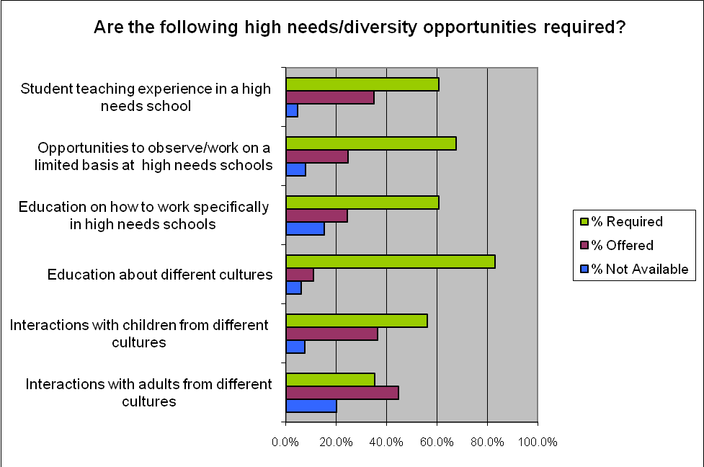

Slide 8
Eight Factors
Derived from factor analysis of scholar survey
Differences in factor scores were compared by gender, major and ethnicity
2) Perceived influence of Noyce scholarship on commitment to teaching in less desirable schools
1) Perceived influence of Noyce scholarship on commitment to teaching (*non-whites higher)
3) Perception of amount of preparation for less desirable schools (*non-whites higher)
5-7) Characteristics within the high needs setting (environment, mentoring *, high needs characteristics* (* non-whites higher)
4) Background in terms of prior work
8) Personal beliefs about teaching

Slide 9
Perceived Influence of Scholarship

Slide 10
Cluster Analyses
3 Clusters
Decreasing influence of Noyce funding
1) Less committed to becoming a teacher and teaching in a high needs school
2) Highly committed to becoming a teacher but not to teaching in a high needs school
1) Highly committed to becoming a teacher and teaching in a high needs school
includes more scholars with high GPAs
no significant differences
includes significantly more scholars of color
career changers evenly distributed across the three clusters

Slide 11
Scholar and Program HLM Analyses
Most of the variance at the scholar level
More variance at program level for becoming teachers (9%) than for teaching in high needs schools (5%)
Few relationships and varied
More funding → more perceived influence
Non-whites higher effect of funding
Preparation for high needs schools positive predictor on teaching in high needs
Path to teaching positive predictor

Slide 12
Results from Hierarchical Linear Modeling
 | Become a teacher |  |  | Teach in a high needs school
 | Outcome variable 1 | Outcome variable 3 |  | Outcome variable 2 | Outcome variable 4
Level 2 (Program Level)
Noyce Funding | ↑ | ↑ |  | ↑
Mean Factor 1: Preparation for high needs schools | ↓
Mean Factor 2: Mentoring experiences
Level 1 (Scholar Level)
Race: 0=Non-white; 1=White | ↓ |  |  |  | ↓
Gender: 0=Female; 1=Male
Factor 1: Preparation for high needs schools |  |  |  | ↑
Factor 2: Mentoring experience
Factor 3: Path to teaching |  | ↑
Note. The direction of the arrows shows the relationship between a predictor
and an outcome variable; “↑” indicates a positive relationship, and “↓”
indicates a negative relationship.

Slide 13
Scholar Model Description
Choosing teaching as a career influenced by: personal traits, content preparation, educational role models and previous careers
Incentives interact with background and both interact with choice to teach and where
Preparation program contributes support structures and experience in/with high needs schools
Retention related to school administration and staff

Slide 14
Conceptual model of the pathway to retention in high needs settings

Slide 15
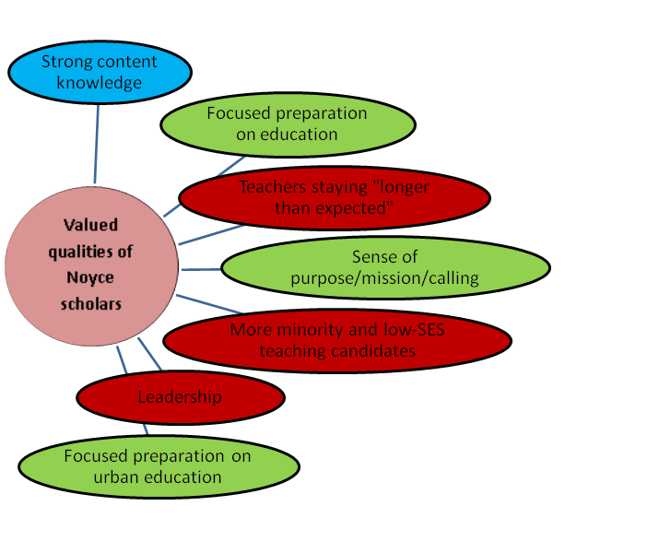
School District Perceptions
Colors indicate number of participants mentioning items
  0-5 responses RED
  6-10 responses GREEN
  11-13 responses BLUE

Slide 16
Perceived Ability of STEM Majors
Faculty Survey

Slide 17
STEM faculty model description
The model indicates the impact of the Noyce program as perceived by STEM faculty. The elements on the right represent the different levels of involvement with the Noyce program that emerged from the analysis. The bullets indicate the outcomes associated with the levels of involvement. The elements on the left, within the circles, indicate the contextual components which enhance the levels of involvement.

Slide 18

Conceptual model indicating the impact of the Noyce program as perceived by STEM faculty
Awareness
“I know that [Noyce] exists”
Emphasis in
higher education on outreach
Increased awareness of STEM education issues
“All I have done is just pass along information”: advertises by passing out flyers or information to all students in STEM classes
Committed to the improvement of STEM education, but views it as someone else’s job
Taught/teaches some scholar in class
NSF prestige
Institutional emphasis on STEM education
National emphasis on STEM education
Faculty teaching education-related courses
Investment
“I know scholars by name”
Professional and personal investment in STEM education issues
Active in advertising and recruitment of scholars
Advises, interviews, selects and evaluates scholars
Small institution
PI in STEM dept.
Education housed within STEM dept. (usually math)

Slide 19
Implications for Preparation Programs
Recruit students carefully
  Scholars with established roots in the community and familiarity/comfortableness with the ‘culture’ of the area were more likely to stay teaching in their high needs school/district.
  Few scholars reported relocating to meet Noyce program high needs requirements
  Scholars with a commitment to ‘give back’
  Scholars of color
Include experiences in high needs settings
Foster personal connections/cohorts

Slide 20
Implications for Scholarship Programs
Many variables involved in the decision to teach in less desirable settings
Decision is a dynamic one with recommitment necessary continuously
Incentives affect decisions before, during and after certification
Amount of funding matters
Differential effect by group

